Slide 1
TSCA Audits Under EPA’s Audit and
New Owner Policies
Ashish P. Deshmukh, PhD
Irene Hantman
Robert DeMott, PhD, Moderator

Slide 2

Irene Hantman
Irene Hantman is an attorney with Verdant Law.
Her practice focuses on the domestic regulation of chemicals and has written extensively on these issues. Ms. Hantman advises clients on the practical implications of final and proposed state and federal legislation and regulations. Her practice also includes enforcement defense.

Slide 3

Setting the Stage

Slide 4

TSCA Compliance
TSCA Mandates
New Substance/New Use Notification (PMN & SNUN)
Export Notification/Import Certification
Restrictions
Prohibition on
use of substances thought to be produced unlawfully
Testing
Reporting
(e.g., CDR)

Slide 5
How EPA Identifies Violations
TSCA inspection by EPA
  Your facility
  Toller
  Your customer’s facility
  Your suppliers
EPA review of submittals (e.g., CDR)
Competitor complaint
Disgruntled employee complaint
Self disclosure

Slide 6
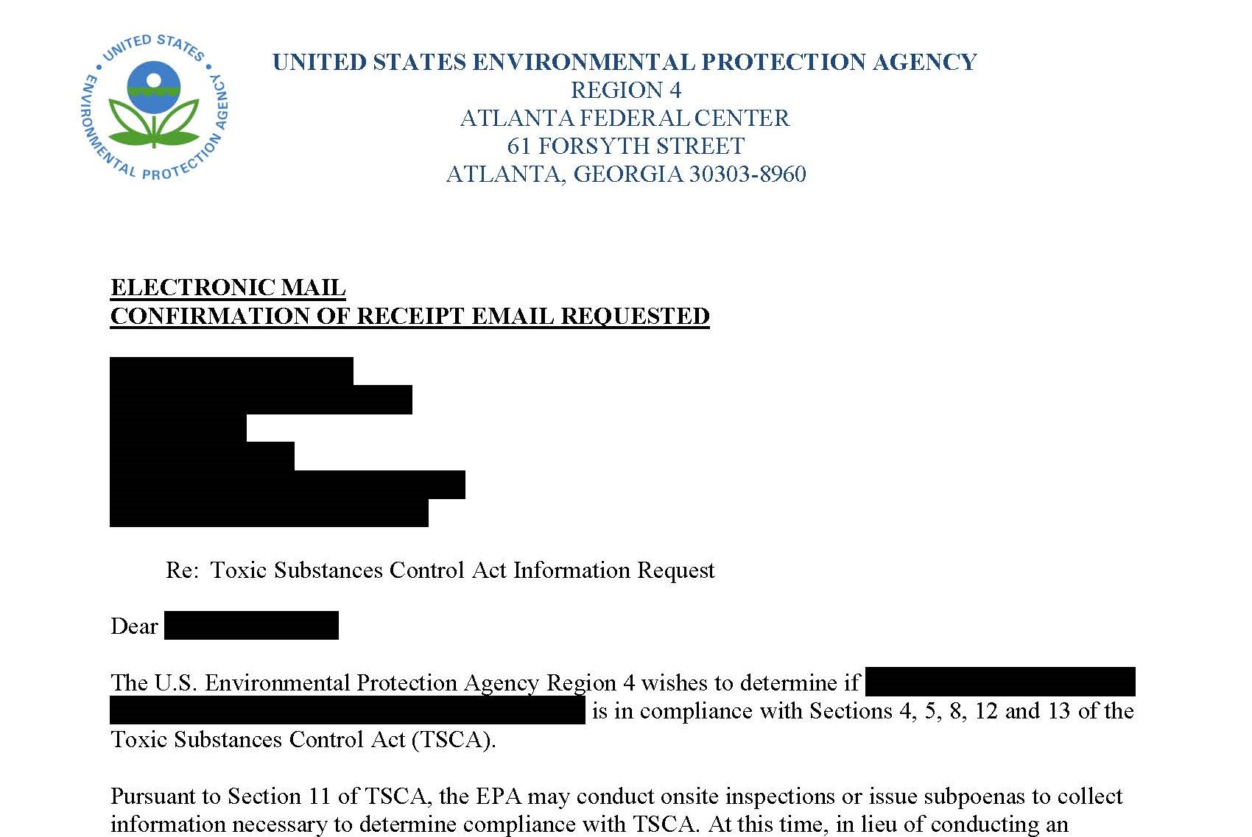
Too late for audit policy protection!
Notes:
May also be worth mentioning that it may not be too late for other facilities, per Ramboll outline
This is a redacted version of the Milliken letter. Let me know if you think it is too gaudy/inappropriate.

Slide 7

EPA Policies

Slide 8

EPA’s Enforcement Response Policies (ERPs)
Strict Liability – If violation occurred, your company
is liable
ERPs vary by section of TSCA
Gravity-based penalty based on three factors:
  Nature
  Circumstances
  Extent
Per-day/one-day violations
Caps on days/maximum assessments
Adjustment factors
  Voluntary disclosure
  Prompt disclosure
Notes:
The penalty for a violation under TSCA is now $46,989. this is adjusted according to the nature, circumstances, and extent of the violation. Manufacturing a new chemical substance (i.e., a substance that is not on the TSCA inventory) for a nonexempt commercial purpose is a Hazard Assessment violation. i.e., the nature of the violation is hazard assessment. EPA considers the violation somewhat serious, especially if the substance would have been the subject of a section 5 consent order and it was distributed to consumers. i.e., the circumstances of the violation are “level 1.” Extent is determined based on the volume of the substance that is at issue. For example, if more than 5000 lbs of the substance was manufactured the extent is considered significant. The penalty is assessed once for every day that the substance was manufactured. The penalty for a significant level 1 violation is approximately $32,000. if the company produced the substance 50 times over the past five years, the penalty could be as much as 1.6 million dollars.

Slide 9

What is EPA’s Audit Policy?
Due to limited government resources, it is necessary for industry to police themselves
Offers major incentives for self-discovery, disclosure, and correction of violations:
  Mitigation of gravity-based penalties
  No recommendations for criminal prosecution
  No routine requests from EPA for the audit report

Slide 10
Conditions for Penalty Mitigation
9 conditions
01
Systematic discovery
06
Prevent recurrence
02
Voluntary discovery
07
No repeat violations
03
Prompt disclosure
08
Violations causing serious harm or imminent/substantial endangerment are ineligible
04
Independent discovery and disclosure
05
Correction and remediation
09
Cooperation

Slide 11
eDisclosure System (since 2015)
01
Receives and automatically processes self-disclosed civil violations
02
Violations must be reported within 21 days of obtaining an “objectively reasonable factual basis” for concluding that specific violations may have occurred (absolute factual and legal certainty is not necessary)
03
Can report as a “potential” violation out of an abundance of caution

Slide 12
Audit Policy Penalty Calculation
01
Elimination of gravity-based penalty if all conditions are met
02
75% reduction of gravity-based penalty if all conditions except systematic discovery are met
03
Still must pay the economic benefit penalty (often negligible for
TSCA violations)

Slide 13


EPA’s New Owner Policy
Penalty mitigation applies to new owners that, within
9 months of the transaction closing:
Promptly disclose violations to EPA, or
Enter into an audit agreement with EPA, and
Meet all conditions of Audit Policy as modified by New Owner Policy
Who is a new owner?
  Prior to transaction not responsible for compliance at facility, didn’t cause violations, couldn’t have prevented violations
  Buyer and seller didn’t have common corporate parent and weren’t closely related
What violations are eligible?
  Violation originated with prior owner
Notes:
Note that this includes less information than prescribed by Ramboll’s outline

Slide 14



Benefits of the New Owner Policy
No penalties will be assessed against new owner for violations that occurred prior to acquisition
More important for stock purchase than asset purchase
Penalties for economic benefit associated with avoided operation and maintenance costs will be assessed against the new owner, but only from the date of acquisition (historically economic benefit penalties not assessed for TSCA violations)
No penalties for economic benefit associated with delayed capital expenditures or with unfair competitive advantage will be assessed against the new owner if the violations are corrected in accordance with the Audit Policy (historically economic benefit penalties not assessed for TSCA violations)
Notes:
Nature of the acquisition matters. Asset purchase – when you buy the stuff (e.g., piece of property), but not the company. Could be very broad all IP, all equipment, all real estate, just not business. Prior owner retains liability for violations.
v. stock purchase – when you buy the company that owns the stuff. All liabilities come along with the stock.
Stock purchase is easier transaction b/c don’t need to get loans, liens, mortgages assigned, transferred, etc.

Slide 15

New Owner Policy and TSCA Audits
Getting a clean baseline
  It will take some time to identify and correct noncompliance
Benefits
1
Opportunity to seek indemnification from seller for breach of reps and warranties
  New owner will have liability from noncompliance until violations are corrected
2
3
Opportunity to submit claim to insurance carrier for deal

Slide 16
Benefits of TSCA Audits
Opportunity to return to compliance without worrying about enforcement
Civil penalty mitigation
Ensuring products in commerce are lawful
Reducing the likelihood of criminal prosecution
Great opportunity for a new management (NOP)
Substantiating “systematic discovery” through audits is easier than through a CMS

Slide 17




Risks of Audits
Companies may not want to take corrective action because it could be costly or painful
  Loss of market access while pursuing PMN or SNUN
Audit Policy is guidance, not the law, not a shield from enforcement
Violations become public
EPA may still perform an inspection during or post-disclosure
Audits cost money and time

Slide 18
Important Considerations
Compliance with the 21-day self-disclosure deadline
Making disclosures after being informed of an upcoming EPA inspection or after an inspection is
not allowed
01
02
Repeat violations not allowed
5-year statute of limitations is applicable to most TSCA violations
03
04

Slide 19
Negotiating with EPA
01
Audit Policy: Securing agreement that audit is all “one look” – to avoid triggering repeat violation
02
New Owner Policy: Negotiating audit agreement
When can new owner enter into an agreement?
How long will audit last?
When will violations be disclosed?

Slide 20

Ashish Deshmukh, PhD
Ashish Deshmukh, PhD, Principal with Ramboll Environment and Health, advises clients on product safety and regulatory compliance issues. He provides strategic and technical advice for managing regulatory risk associated with industrial chemicals, food contact substances, and antimicrobials.
His specialized experience includes regulatory approvals for products, and audits under EPA’s Audit Policy. He has previously worked in the pesticide industry with responsibilities in product development, regulatory affairs, and general management.

Slide 21
Technical Aspects of TSCA Audits

Slide 22
Agenda
Drivers for TSCA audits
Types of TSCA audits
Audit process
Challenges faced during audits
Case studies
Product stewards’ roles in TSCA audits

Slide 23
Drivers for TSCA Audits
Corporate audit programs
Identified or suspected compliance issues
Mergers and acquisitions
  Pre-sale audit by seller
  Pre-purchase due diligence
  New Owner Audit
Systems audits as part of corrective action negotiated with EPA
TSCA audits may
be driven by various factors

Slide 24
Types of TSCA Audits
Compliance versus Systems audits
Comprehensive versus Focused audits
Completely remote versus combination of remote and site visits
Under “Attorney Client Privilege” versus not
TSCA audits are designed based on the drivers

Slide 25
Audit Team
Technical consultants/external auditors
Attorneys, in-house and outside counsel
Internal to the company (corporate or facility personnel)
Audit team is designed appropriately to meet audit needs

Slide 26

Audit Process

Slide 27
Audit Process – Information gathering and prioritization
Number and types of facilities
TSCA-regulated activities
Finalize scope of audit
Prioritize facilities for audit (risk-based)
Prepare schedule
Prepare audit protocol
Initial information leads to definition
of scope and prioritization of activities

Slide 28
Audit Process –
Protocol Development
Consider and work with existing protocol
Tailored to the audit’s requirements
  Clients’ requirements
  Specific issues, e.g., chemical nomenclature/identity, polymer exemption, articles exemption, Chemical Data Reporting (CDR), h(7) exemption, R&D exemption
Requirements of outside counsel
EPA’s Audit Policy
Protocols are tailored to meet the audit’s requirements

Slide 29
Audit Process –
Initial audit activities
Facility questionnaire
Orientation call
Document and information requests
Secure FTP site for document uploads
General document review
TSCA substance review (section checks)
Tracking methodology
Certain activities are completed at the beginning of the audit as pre-work
for the site visit

Slide 30
Audit Process –
On-site audit activities
Opening meeting
Site tour
Interviews
On-site records review
  EPA submissions
  EPA Inspection and previous audit reports
  Recordkeeping requirements
Closing conference
The site visit is conducted to carefully review manufacturing processes and documents

Slide 31
Audit Process –
Off-site detailed reviews
Interpreting product chemistry
  Prioritization of products
  Process flow diagrams
  Bills of materials
  Discussions with SMEs
Import and export reviews
  Sampling of transactions
Co-manufacturing reviews
Certain time-intensive activities are completed remotely

Slide 32
Audit Process –
Post-review activities
Coordination with internal and outside attorneys
  Managing discovery process
Analysis and finalization of findings
Voluntary disclosure
Corrective actions
Compliance certification
Audit report preparation
We work with attorneys for legal coordination and to ensure Audit Policy conditions are met

Slide 33
Challenges faced during audits
Staff turnover
Company acquisitions/divestitures/reorganizations
No chemical data management system
Lack of raw material reviews
Poor recordkeeping (old or non-US SDSs, no CDR data)
Working with suppliers
Each audit brings
its own challenges

Slide 34

Case Study 1
3D Printing Company

Slide 35
3D Printing Company
Comprehensive TSCA Audit
In 2018 EPA discovered TSCA Section 5 violations for two imported substances
Company paid $200,000 in fines
Company decided to conduct a TSCA audit under EPA’s Audit Policy

Slide 36



3D Printing Company
Scope of TSCA Audit
Distributed questionnaires to facilities domestically and abroad
Reviewed relevant information and documents, including lists of raw materials and finished goods, SDSs, batch sheets, CDR records, import and export records, etc.
Visited seven facilities, both domestic and international
Voluntarily disclosed violations, performed corrective action, and submitted compliance certification

Slide 37
3D Printing Company
Findings from the TSCA Audit
  Section 5 Regulated Substances
  No notification to downstream customers about presence of SNUR substances
  No knowledge about presence of substance with Section 5(e) Consent Order
  Section 8(a) Chemical Data Reporting (CDR)
  Calculated volumes were different from those previously reported
  Section 12(b) Export Notification
  No export notifications were submitted during the audit period
  Section 13
  Imports
  TSCA import certifications were not submitted for some chemicals mistakenly classified as articles

Slide 38
3D Printing Company
Root cause analysis
Regulatory Affairs Department was at HQ outside the US
Miscommunication between Purchasing Department and Customs Brokers about reporting responsibilities
Sales Department responsible for exports lacks TSCA knowledge
Personnel changes led to lost records like CDR volume calculations

Slide 39
Case Study 2
Petrochemical Company

Slide 40
Petrochemical Company
Focused TSCA Audit
  Company was informed by an NGO that it had failed to include one imported chemical in its submission under the TSCA CDR rule
  An internal investigation identified systemic issues related to CDR reporting of imports
  Company commissioned a TSCA CDR audit for eight facilities

Slide 41
Petrochemical Company
Scope of TSCA Audit
Audit was performed remotely
Reviewed CDR reports
Distributed questionnaires
Reviewed manufacturing and co-manufacturing operations
Interviewed personnel
Reviewed import transactions data
Conducted regulatory reviews of raw materials, isolated intermediates, products, by-products, recycled materials
Voluntary disclosure, corrective action, compliance certification
Performed root cause analysis

Slide 42
Petrochemical Company
Root cause analysis
Identities of manufactured substances were not confirmed unambiguously
Manufacturing processes were not completely evaluated
Process reviews were not conducted on an ongoing basis
Methodology for collection of volume data was not documented
Data was collected every four years instead of more frequently
Raw data and calculations were not documented
Responsibilities for co-manufacturing were not clearly understood
Responsibilities for reporting imports not clearly delineated between facilities and HQ

Slide 43

How Can Product Stewards Prepare for TSCA Audits?

Slide 44
Preparing for TSCA Audits
Organization chart
Previous EPA inspection reports
Reports of previous TSCA audits
Manufacturing
  List of products
  Manufacturing process information
  Identify personnel knowledgeable about processes
  Manufactured volumes of products
  List of maintenance and cleaning chemicals
Research & Development
  List of chemicals handled under the TSCA R&D exemption

Slide 45



Preparing for TSCA Audits
Purchasing Department
List of raw materials purchased
List of co-manufactured products purchased
List of imported materials and import summaries from Customs Brokers
Sales Department
List of exported products
EHS
OSHA injury logs and other health & safety data
Product Stewardship & Regulatory Affairs
Chemical database demonstrating TSCA compliance of materials
Updated safety data sheets for raw materials

Slide 46
Preparing for TSCA Audits
Regulatory submissions
EPA submissions related to Section 4 Test Rules/Orders
Bona fide intent (BFI) requests
Pre-market Notices
Section 8(a) CDR rule submissions
Section 8(d) health and safety rule submissions
Section 8(e) substantial risk submissions
Section 12(b) export notifications
Section 13 import certifications
Inventory Reset Rule (IRR), Mercury Rule, and Nanomaterials Rule

Slide 47
Preparing for TSCA Audits
Regulatory recordkeeping
Section 5(e) Consent Orders (COs) compliance
Significant New Use Rules (SNURs) compliance
Section 6 Risk Management Rules compliance
Low Volume Exemptions (LVEs) compliance
Polymer Exemptions (PEs) compliance
TSCA R&D exemption compliance
CDR calculations and reportability determinations
8(c) and 8(e) records with H&S records

Slide 48
Managing TSCA compliance
Designate a TSCA Coordinator
Maintain a substance database
Implement a system to perform due diligence on raw materials
Evaluate all manufacturing processes for TSCA compliance
Prepare Standard Operating Procedures for TSCA compliance
Maintain records of all TSCA submissions to and correspondence with EPA
Maintain records of compliance with all applicable TSCA rules
Provide TSCA training

Slide 49
Conclusions
TSCA impacts a broad cross-section of industries
TSCA compliance is a moving target
Implementing a TSCA Compliance Management System and performing TSCA audits at a regular frequency is recommended to ensure ongoing compliance
EPA’s Audit Policy and New Owner Policy offer a valuable opportunity for mitigation of penalties
Product stewards have an important role to play in facilitating TSCA audits

Slide 50
Questions?

Slide 51

Contact Information
Verdant Law
Irene Hantman
ihantman@verdantlaw.com
Ramboll
Ashish P. Deshmukh
adeshmukh@ramboll.com
Ramboll
Robert DeMott
rdemott@ramboll.com

